Slide 1
Unit - 1
Introduction: Foundations of AI, History, State of the Art, Risks and Benefits.
Intelligent agents: Agents and Environment, The Concept of Rationality, Structure of an Agent.
Solving problems by Search- Problem-Solving Agents, State space representation, Search graph and Search tree Searching for Solutions,

Slide 2
What is Artificial Intelligence
AI provides satisficing solutions
AI provides general solutions to a problem in a particular domain.
AI deals with problems which take exponential time to solve. The goal of AI is to reduce the exponential times to polynomial times. This goal is achieved by being tolerant to imprecision, uncertainty, partial truth and approximation.

Slide 3
More Formal Definition of AI
  AI is a branch of computer science which is concerned with the study and creation of computer systems that exhibit
      some form of intelligence
      OR
      those characteristics which we associate with intelligence in human behavior

Slide 4
What is Intelligence?
Intelligence is a property of mind that encompasses many related mental abilities, such as the capabilities to
  reason
  plan
  solve problems
  think abstractly
  comprehend ideas and language and
  learn

Slide 5
Intelligence - Ability to apply knowledge in order to perform better in an environment.
Artificial Intelligence - Study and construction of agent programs that perform well in a given environment, for a given agent architecture.
Agent - An entity that takes action in response to percepts from an environment.
Rationality - property of a system which does the “right thing” given what it knows.
Logical Reasoning - A process of deriving new sentences from old, such that the new sentences are necessarily true if the old ones are true.

Slide 6
Characteristics of AI systems
learn new concepts and tasks
reason and draw useful conclusions about the world around us
  remember complicated interrelated facts and draw conclusions from them (inference)
understand a natural language or perceive and comprehend a visual scene
  look through cameras and see what's there (vision), to move themselves and objects around in the real world (robotics)

Slide 7
Contd..
plan sequences of actions to complete a goal
offer advice based on rules and situations
may not necessarily imitate human senses and thought processes
  but indeed, in performing some tasks differently, they may actually exceed human abilities
capable of performing intelligent tasks effectively and efficiently
perform tasks that require high levels of intelligence

Slide 8
Understanding of AI
AI techniques and ideas seem to be harder to understand than most things in computer science
AI shows best on complex problems for which general principles don't help much, though there are a few useful general principles

Slide 9
Artificial intelligence is also difficult to understand by its content.
Boundaries of AI are not well defined.
Often it means the advanced software engineering, sophisticated software techniques for hard problems that can't be solved in any easy way.
AI programs - like people - are usually not perfect, and even make mistakes.

Slide 10
It often means, nonnumeric ways of solving problems, since people can't handle numbers well.
Nonnumeric ways are generally "common sense" ways, not necessarily the best ones.
Understanding of AI also requires an understanding of related terms such as intelligence, knowledge, reasoning, thought, cognition, learning, and a number of other computer related terms.

Slide 11
Categories of AI System
Systems that think like humans
Systems that act like humans
Systems that think rationally
Systems that act rationally

Slide 12
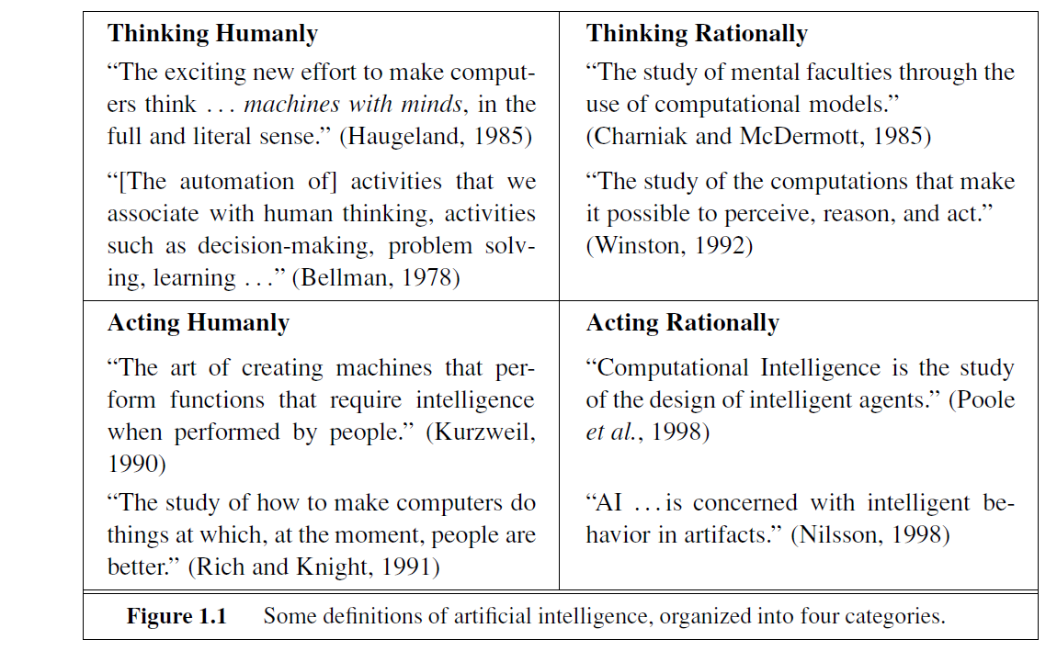

Slide 13
The Turing Test
  Turing proposed operational test for intelligent
  behavior in 1950.
  Human
  Human ?
  Interrogator
  AI system

Slide 14
ELIZA
Eliza was first program developed by Joseph Wiezbaum to converse in English in mid 1960's
  It passed turing test.
The following passage shows Eliza’s talking to a teenage girl. Blue text Eliza’s response
Men are all alike.
IN WHAT WAY
They're always bugging us about something or other.
CAN YOU THINK OF A SPECIFIC EXAMPLE

Slide 15
Acting humanly: The Turing Test approach
The Turing Test, proposed by Alan Turing TURING TEST (1950), was designed to provide a satisfactory operational definition of intelligence. A computer passes the test if a human interrogator, after posing some written questions, cannot tell whether the written responses come from a person or from a computer. The computer would need to possess the following capabilities:
natural language processing to enable it to communicate successfully in English;
knowledge representation to store what it knows or hears;
• automated reasoning to use the stored information to answer questions and to draw
machine learning to adapt to new circumstances and to detect and extrapolate patterns.
computer vision to perceive objects, and
robotics to manipulate objects and move about.

Slide 16
2. Thinking humanly: The cognitive modeling approach
If we are going to say that a given program thinks like a human, we must have some way of determining how humans think. We need to get inside the actual workings of human minds.
There are three ways to do this: through introspection—trying to catch our own thoughts as they go by; through psychological experiments—observing a person in action; and through brain imaging — observing the brain in action.
The interdisciplinary field of cognitive science brings together computer models from AI and experimental techniques from psychology to construct precise and testable theories of the human mind.

Slide 17
3. Thinking rationally: The “laws of thought” approach
The Greek philosopher Aristotle was one of the first to attempt to codify “right thinking,” that is, irrefutable reasoning processes. His syllogisms provided patterns for argument structures that always yielded correct conclusions when given correct premises.
Ex: “Socrates is a man; all men are mortal; therefore, Socrates is mortal.” These laws of thought were supposed to govern the operation of the mind; their study initiated the field called logic.

Slide 18
4. Acting rationally: The rational agent approach
An agent is just something that acts (agent comes from the Latin agere, to do). All computer programs do something, but computer agents are expected to do more: operate autonomously, perceive their environment, persist over a prolonged time period, adapt to change, and create and pursue goals.
A rational agent is one that acts so as to achieve the best outcome or, when there is uncertainty, the best expected outcome.

Slide 19
Foundations of AI
    Foundation of AI is based on
      Mathematics
      Neuroscience
      Control Theory
      Linguistics

Slide 20
Two Views of AI Goals
AI is about duplicating what the (human) brain DOES
  Cognitive Science
AI is about duplicating what the (human) brain SHOULD do
  Rationality (doing things logically)

Slide 21
AI problems
Game playing agents
Machine learning
Speech
Language
Vision
Data Mining
Web agents …….
Medical Diagnosis
Fraud Detection
Object Identification
Space Shuttle Scheduling
Information Retrieval ….

Slide 22
AI Technique
  Rule-based
  Fuzzy Logic
  Neural Networks
  Genetic Algorithms

Slide 23
Applications
Some of the applications are given below:
  Business : Financial strategies, give advice
  Engineering: check design, offer suggestions to create new product
  Manufacturing: Assembly, inspection & maintenance
  Mining: used when conditions are dangerous
  Hospital : monitoring, diagnosing & prescribing
  Education : In teaching
  household : Advice on cooking, shopping etc.
  farming : prune trees & selectively harvest mixed crops.

Slide 24
History of AI
Year | Milestone / Innovation
1923 | Karel Čapek play named “Rossum's Universal Robots” (RUR) opens in London, first use of the word "robot" in English.
1943 | Foundations for neural networks laid.
1945 | Isaac Asimov, a Columbia University alumni, coined the term Robotics.
1950 | Alan Turing introduced Turing Test for evaluation of intelligence and published Computing Machinery and Intelligence. Claude Shannon published Detailed Analysis of Chess Playing as a search.
1956 | John McCarthy coined the term Artificial Intelligence. Demonstration of the first running AI program at Carnegie Mellon University.
1958 | John McCarthy invents LISP programming language for AI.
1964 | Danny Bobrow's dissertation at MIT showed that computers can understand natural language well enough to solve algebra word problems correctly.
7

Slide 25
History of AI
1965 | Joseph Weizenbaum at MIT built ELIZA, an interactive problem that carries on a dialogue in English.
1969 | Scientists at Stanford Research Institute Developed Shakey, a robot, equipped with locomotion, perception, and problem solving.
1973 | The Assembly Robotics group at Edinburgh University built Freddy, the Famous Scottish Robot, capable of using vision to locate and assemble models.
1979 | The first computer-controlled autonomous vehicle, Stanford Cart(Stanely), was built.
1985 | Harold Cohen created and demonstrated the drawing program, Aaron.

Slide 26
History of AI
1990 | Major advances in all areas of AI − Significant demonstrations in machine learning Case-based reasoning Multi-agent planning Scheduling Data mining, Web Crawler natural language understanding and translation Vision, Virtual Reality Games
1997 | The Deep Blue Chess Program beats the then world chess champion, Garry Kasparov.
2000 | Interactive robot pets become commercially available. MIT displays Kismet, a robot with a face that expresses emotions. The robot Nomad explores remote regions of Antarctica and locates meteorites.

Slide 27
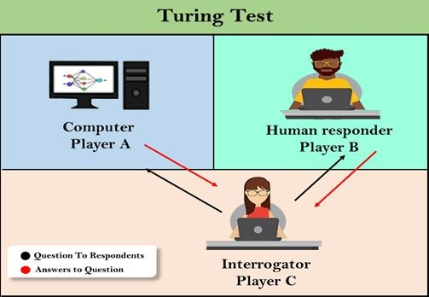

Slide 28
Intelligent Agents

Slide 29
Agents
An agent is anything that can be viewed as perceiving its environment through sensors and acting upon that environment through actuators
•

Slide 30
Agents contd..
Human agent: eyes, ears, and other organs for sensors hands,legs, mouth, and other body parts for actuators.
Robotic agent: cameras and infrared range finders for sensors various motors for actuators.

Slide 31
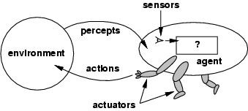
Agents and environments
The agent function maps from percept histories to actions:
The agent program runs on the physical architecture to produce f
agent = architecture + program

Slide 32

Vacuum-cleaner world
Percepts: location and contents, e.g., [A,Dirty]
Actions: Left, Right, Suck, NoOp

Slide 33
Rational agents
An agent should strive to "do the right thing", based on what it can perceive and the actions it can perform. The right action is the one that will cause the agent to be most successful
Performance measure: An objective criterion for success of an agent's behavior.
E.g., performance measure of a vacuum-cleaner agent could be amount of dirt cleaned up, amount of time taken, amount of electricity consumed, amount of noise generated, etc.

Slide 34
Rational agents
Rational Agent:
For each possible percept sequence, a rational agent should select an action that is expected to maximize its performance measure, given the evidence provided by the percept sequence and whatever built-in knowledge the agent has.

Slide 35
Rational agents
Rationality is distinct from omniscience (all-knowing with infinite knowledge)
Agents can perform actions in order to modify future percepts so as to obtain useful information (information gathering, exploration)
An agent is autonomous if its behavior is determined by its own experience (with ability to learn and adapt)

Slide 36
PEAS
Consider, e.g., the task of designing an automated taxi driver:
  Performance measure
  Environment
  Actuators
  Sensors

Slide 37
the task of designing an automated taxi driver
Performance measure: Safe, fast, legal, comfortable trip, maximize profits
Environment: Roads, other traffic, pedestrians, customers
Actuators: Steering wheel, accelerator, brake, signal, horn
Sensors: Cameras, sonar, speedometer, GPS, odometer, engine sensors, keyboard

Slide 38
Agent: Medical diagnosis system

Slide 39
Agent: Medical diagnosis system
Performance measure: Healthy patient, minimize costs, lawsuits
Environment: Patient, hospital, staff
Actuators: Screen display (questions, tests, diagnoses, treatments, referrals)
Sensors: Keyboard (entry of symptoms, findings, patient's answers)

Slide 40
Agent: Interactive English tutor

Slide 41
Agent: Interactive English tutor
Performance measure: Maximize student's score on test
Environment: Set of students
Actuators: Screen display (exercises, suggestions, corrections)
Sensors: Keyboard

Slide 42
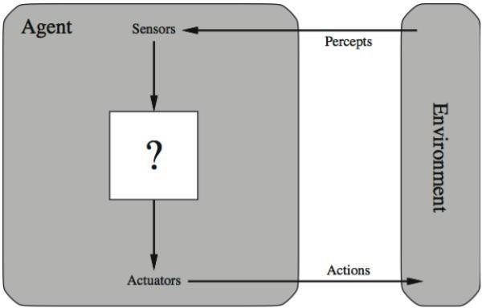
Agent

Slide 43
Human-Agent: A human agent has eyes, ears, and other organs which work for sensors and hand, legs, vocal tract work for actuators.
Robotic Agent: A robotic agent can have cameras, infrared range finder, NLP for sensors and various motors for actuators.
Software Agent: Software agent can have keystrokes, file contents as sensory input and act on those inputs and display output on the screen.
Hence the world around us is full of agents such as thermostat, cell phone, camera, and even we are also agents. Before moving forward, we should first know about sensors, effectors, and actuators.
Sensor: Sensor is a device which detects the change in the environment and sends the information to other electronic devices. An agent observes its environment through sensors.
Actuators: Actuators are the component of machines that converts energy into motion. The actuators are only responsible for moving and controlling a system. An actuator can be an electric motor, gears, rails, etc.
Effectors: Effectors are the devices which affect the environment. Effectors can be legs, wheels, arms, fingers, wings, fins, and display screen.

Slide 44
  PROPERTIES OF ENVIRONMENT
An environment is everything in the world which surrounds the agent, but it is not a part of an agent itself. An environment can be described as a situation in which an agent is present.
The environment is where agent lives, operate and provide the agent with something to sense and act upon it.

Slide 45
1. Fully observable vs Partially Observable:
If an agent sensor can sense or access the complete state of an environment at each point of time then it is a fully observable environment, else it is partially observable.
A fully observable environment is easy as there is no need to maintain the internal state to keep track history of the world.
An agent with no sensors in all environments then such an environment is called as unobservable.
Example: chess – the board is fully observable, as are opponent’s moves. Driving
– what is around the next bend is not observable and hence partially observable.

Slide 46
2. Deterministic vs Stochastic
If an agent's current state and selected action can completely determine the next state of the environment, then such environment is called a deterministic environment.
A stochastic environment is random in nature and cannot be determined completely by an agent.
In a deterministic, fully observable environment, agent does not need to worry about uncertainty.

Slide 47
3. Episodic vs Sequential
In an episodic environment, there is a series of one-shot actions, and only the current percept is required for the action.
However, in Sequential environment, an agent requires memory of past actions to determine the next best actions.

Slide 48
4. Single-agent vs Multi-agent
If only one agent is involved in an environment, and operating by itself then such an environment is called single agent environment.
However, if multiple agents are operating in an environment, then such an environment is called a multi-agent environment.
The agent design problems in the multi-agent environment are different from single agent environment.

Slide 49
5. Static vs Dynamic
If the environment can change itself while an agent is deliberating then such environment is called a dynamic environment else it is called a static environment.
Static environments are easy to deal because an agent does not need to continue looking at the world while deciding for an action.
However for dynamic environment, agents need to keep looking at the world at each action.
Taxi driving is an example of a dynamic environment whereas Crossword puzzles are an example of a static environment.

Slide 50
6.Discrete vs Continuous
If in an environment there are a finite number of precepts and actions that can be performed within it, then such an environment is called a discrete environment else it is called continuous environment.
A chess game comes under discrete environment as there is a finite number of moves that can be performed.
A self-driving car is an example of a continuous environment.7.

Slide 51
7. Known vs Unknown
Known and unknown are not actually a feature of an environment, but it is an agent's state of knowledge to perform an action.
In a known environment, the results for all actions are known to the agent. While in unknown environment, agent needs to learn how it works in order to perform an action.
It is quite possible that a known environment to be partially observable and an Unknown environment to be fully observable.

Slide 52
8. Accessible vs. Inaccessible
If an agent can obtain complete and accurate information about the state's environment, then such an environment is called an Accessible environment else it is called inaccessible.
An empty room whose state can be defined by its temperature is an example of an accessible environment.
Information about an event on earth is an example of Inaccessible environment.

Slide 53
PEAS: Performance Measure, Environment, Actuators, Sensors
Performance
The output which we get from the agent. All the necessary results that an agent gives after processing comes under its performance.
Environment:
All the surrounding things and conditions of an agent fall in this section. It basically consists of all the things under which the agents work.
Actuators :
The devices, hardware or software through which the agent performs any actions or processes any information to produce a result are the actuators of the agent.
Sensors:
The devices through which the agent observes and perceives its environment are the sensors of the agent.

Slide 54
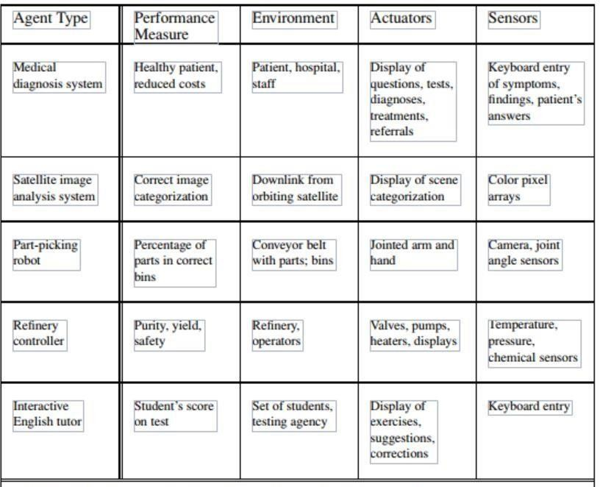
Figure 1.5 Examples of agent types and their PEAS descriptions

Slide 55
Rational Agent - A system is rational if it does the “right thing”. Given what it knows.
Characteristic of Rational Agent
The agent's prior knowledge of the environment.
The performance measure that defines the criterion of success.
The actions that the agent can perform.
The agent's percept sequence to date.
For every possible percept sequence, a rational agent should select an action that is expected to maximize its performance measure, given the evidence provided by the percept sequence and whatever built-in knowledge the agent has.

Slide 56
An omniscient agent knows the actual outcome of its actions and can act accordingly; but omniscience is impossible in reality.
Ideal Rational Agent precepts and does things. It has a greater performance measure.
Eg. Crossing road. Here first perception occurs on both sides and then only action. No perception occurs in Degenerate Agent.
Eg. Clock. It does not view the surroundings. No matter what happens outside. The clock works based on inbuilt program.
Ideal Agent describes by ideal mappings. “Specifying which action an agent ought to take in response to any given percept sequence provides a design for ideal agent”.
Eg. SQRT function calculation in calculator.
Doing actions in order to modify future precepts-sometimes called information gathering- is an important part of rationality.

Slide 57
A rational agent should be autonomous-it should learn from its own prior knowledge (experience).
The Structure of Intelligent Agents
Agent = Architecture + Agent Program
Architecture = the machinery that an agent executes on. (Hardware)
Agent Program = an implementation of an agent function. (Algorithm, Logic – Software)

Slide 58
Types of Agents
Table Driven Agents
Simple Reflex Agents
Model based Reflex Agents
Goal based Agents
Utility Based Agents
Learning Agents

Slide 59
Table Driven Agents:
Table based information about the agent’s percept.
Mapping can be implemented by rule based system, Nn methods.
If table becomes very large learning the table may take long time.

Slide 60
Simple Reflex Agents or Percept based
E
n v i o r n m e n t
Agent
Sensors
What the world is like now?
Conditions action rules
What action should I do now?
Actuators
Information comes from sensors-Percepts Changes the agent current state of the world Triggers actions through the effectors
No notion of history,no internal representation,no strategic planning

Slide 61
Model based reflex Agents
Information comes from sensors-Percepts Changes the agent current state of the world
Based on the state of the world and knowledge(memory),it triggers actions through the effectors.
E
n v i o r n m e n
state
Sensors
What the world is like now?
How world evolves
What my actions do
What action should I do now?
Conditions action rules
Actuators
t
Agent

Slide 62
Goal based Agents
Information comes from sensors-Percepts Changes the agent current state of the world
Based on the state of the world and knowledge(memory), and goals / intentions it chooses actions through the effectors.
E
n v i o r n m e n
state
Sensors
What the world is like now?
How world evolves
What my actions do
What it will be like if I do action A
What action should I do now?
GOALS
Actuators
t
Agent

Slide 63
Utility based Agents
Information comes from sensors-Percepts Changes the agent current state of the world
Based on the state of the world and knowledge(memory), and goals / intentions it chooses actions through the effectors.
E
n v i o r n m e n t
state
Sensors
What the world is like
now?
How world evolves
What my actions do
What it will be like if I do action A
How happy I will be in
such a state
Utility
What action should I
do now?
Agent
Actuators

Slide 64
Environment types
Fully observable (vs. partially observable): An agent's sensors give it access to the complete state of the environment at each point in time.
Deterministic (vs. stochastic): The next state of the environment is completely determined by the current state and the action executed by the agent. (If the environment is deterministic except for the actions of other agents, then the environment is strategic)
Episodic (vs. sequential): The agent's experience is divided into atomic "episodes" (each episode consists of the agent perceiving and then performing a single action), and the choice of action in each episode depends only on the episode itself.
•

Slide 65
Environment types
Static (vs. dynamic): The environment is unchanged while an agent is deliberating. (The environment is semidynamic if the environment itself does not change with the passage of time but the agent's performance score does)
Discrete (vs. continuous): A limited number of distinct, clearly defined percepts and actions.
Single agent (vs. multiagent): An agent operating by itself in an environment.
•

Slide 66
Problem Solving Agent

Slide 67
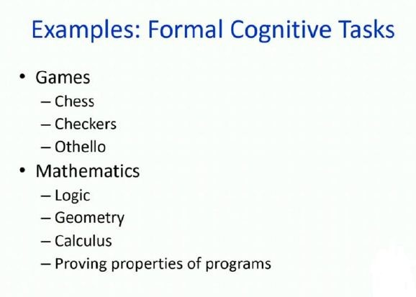
Types Of Problems

Slide 68
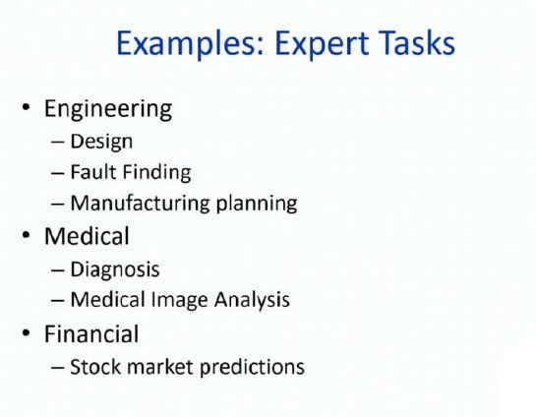
Contd..

Slide 69
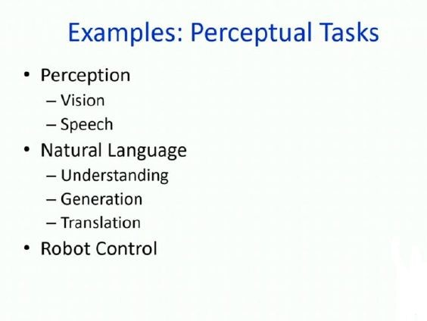
Contd..

Slide 70
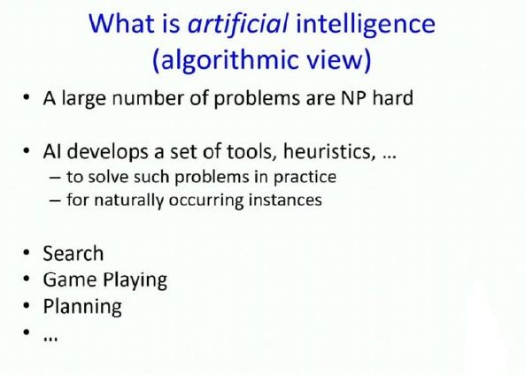

Slide 71
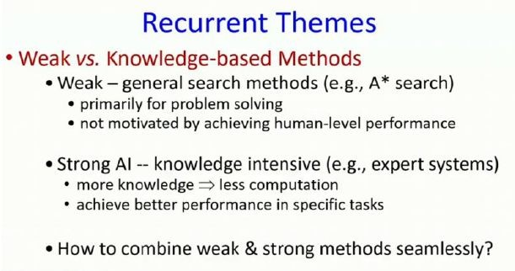

Slide 72
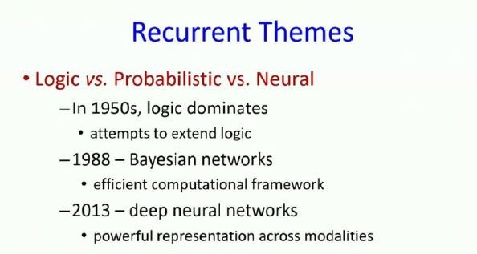

Slide 73
Problem-Solving Agents
Intelligent agents can solve problems by searching a state-space
State-space Model
  the agent’s model of the world
  usually a set of discrete states
  e.g., in driving, the states in the model could be towns/cities

Slide 74
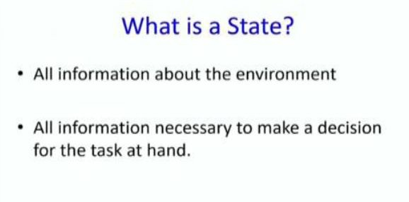
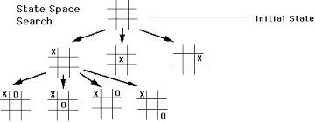

Slide 75
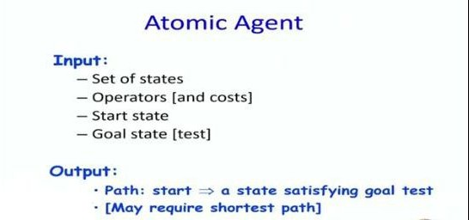

Slide 76
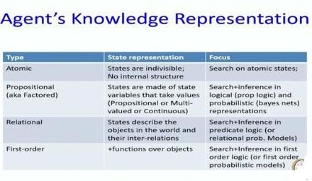

Slide 77
Goal State(s)
  a goal is defined as a desirable state for an agent
  there may be many states which satisfy the goal test
    e.g., drive to a town with a ski-resort
  or just one state which satisfies the goal
    e.g., drive to Mammoth
Operators (actions, successor function)
  operators are legal actions which the agent can take to move from one state to another

Slide 78
The State-Space Graph
Graphs:
  nodes, arcs, directed arcs, paths
Search graphs:
  States are nodes
  operators are directed arcs
  solution is a path from start S to goal G
Problem formulation:
  Give an abstract description of states, operators, initial state and goal state.
Problem solving:
  Generate a part of the search space that contains a solution

Slide 79
Some example problems
Toy problems and micro-worlds
  8-Puzzle
  Missionaries and Cannibals
  Cryptarithmetic
  Remove 5 Sticks
  Water Jug Problem
Real-world problems

Slide 80
8-puzzle problem
State: 3 x 3 array of the tiles on the board.
Operators: Move Blank Square Left, Right, Up or Down.
– This is a more efficient encoding of the operators than one in which each of four possible moves for each of the 8 distinct tiles is used.
Initial State: A particular configuration of the board.
Goal: A particular configuration of the board.

Slide 81
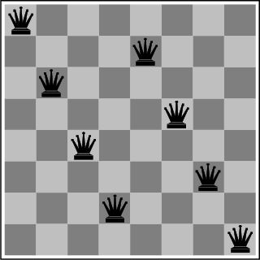
The 8-Queens Problem
Place eight queens on a chessboard such that no queen attacks any other!

Slide 82
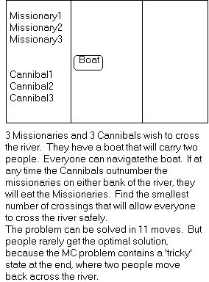
Missionaries and Cannibals
There are 3 missionaries, 3 cannibals, and 1 boat that can carry up to two people on one side of a river.
Goal: Move all the missionaries and cannibals across the river.
Constraint: Missionaries can never be outnumbered by cannibals on either side of river, or else the missionaries

Slide 83
Missionaries and Cannibals Solution
 | Near side |  | Far side
0 Initial setup: | MMMCCC | B | -
1 Two cannibals cross over: | MMMC |  | B CC
2 One comes back: | MMMCC | B | C
3 Two cannibals go over again: | MMM |  | B CCC
4 One comes back: | MMMC | B | CC
5 Two missionaries cross: | MC |  | B MMCC
6 A missionary & cannibal return: | MMCC | B | MC
7 Two missionaries cross again: | CC |  | B MMMC
8 A cannibal returns: | CCC | B | MMM
9 Two cannibals cross: | C |  | B MMMCC
10 One returns: | CC | B | MMMC
11 And brings over the third: | - |  | B MMMCCC

Slide 84
Cryptarithmetic
Find an assignment of digits (0, ..., 9) to letters so that a given arithmetic expression is true. examples: SEND + MORE = MONEY and
 | FORTY | Solution: | 29786
+ | TEN |  | 850
+ | TEN |  | 850
SIXTY
F=2, O=9, R=7, etc.
31486
Note: In this problem, the solution is NOT a sequence of actions that transforms the initial state into the goal state; rather, the solution is a goal node that includes an assignment of digits to each of the distinct letters in the given problem.

Slide 85
Remove 5 Sticks
Given the following configuration of sticks, remove exactly 5 sticks in such a way that the remaining configuration forms exactly 3 squares.

Slide 86
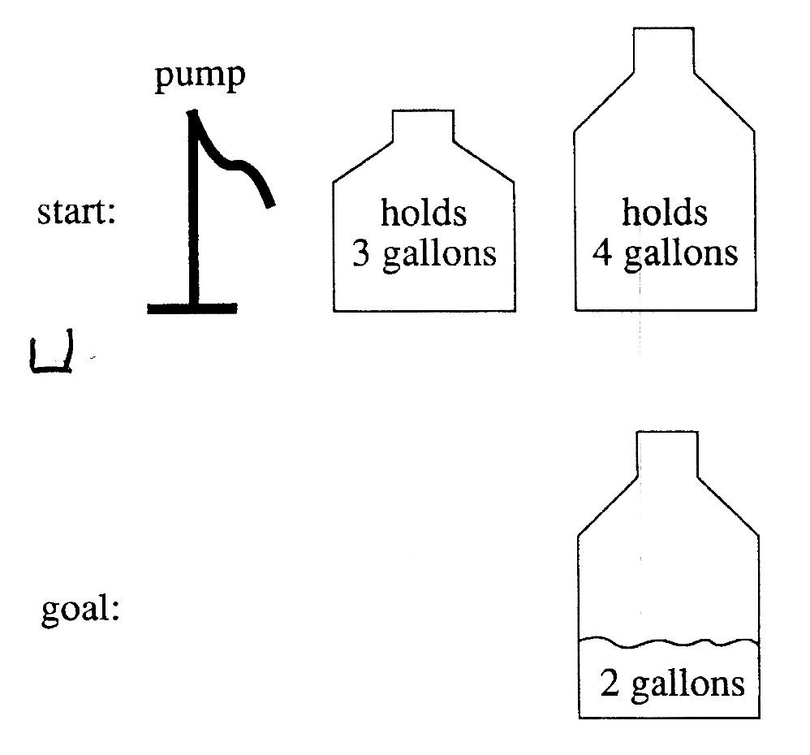
A Water Jug Problem
You have a 4-gallon and a 3-gallon water jug
You have a faucet with an unlimited amount of water
You need to get exactly 2 gallons in 4-gallon jug

Slide 87
Puzzle-solving as Search
State representation: (x, y)
  x: Contents of four gallon
  y: Contents of three gallon
Start state: (0, 0)
Goal state (2, n)
Operators
  Fill 3-gallon from faucet, fill 4-gallon from faucet
  Fill 3-gallon from 4-gallon , fill 4-gallon from 3-gallon
  Empty 3-gallon into 4-gallon, empty 4-gallon into 3-gallon
  Dump 3-gallon down drain, dump 4-gallon down drain

Slide 88
Production Rules for the Water Jug Problem
Fill the 4-gallon jug
1 (x,y) → (4,y) if x < 4
2 (x,y) → (x,3) if y < 3
3 (x,y) → (x – d,y) if x > 0
4 (x,y) → (x,y – d) if y > 0
5 (x,y) → (0,y) if x > 0
(x,y) → (x,0) if y > 0
7. x,y) →(4, y – (4 – x )
if x + y ≥ 4 and y > 0
Fill the 3-gallon jug
Pour some water out of the 4-gallon jug
Pour some water out of the 3-gallon jug Empty the 4-gallon jug on the ground Empty the 3-gallon jug on the ground Pour water from the 3-gallon jug into the
4-gallon jug until the 4-gallon jug is full

Slide 89
The Water Jug Problem (cont’d)
8 (x,y) →(x – (3 – y),3)
if x + y ≥ 3 and x > 0
9 (x,y) → (x + y, 0)
if x + y ≤ 4 and y > 0
10 (x,y) → (0, x + y)
if x + y ≤ 3 and x > 0
Pour water from the 4-gallon jug into the
3-gallon jug until the 3-gallon jug is full
Pour all the water from the 3-gallon jug into the 4-gallon jug
Pour all the water from the 4-gallon jug into the 3-gallon jug

Slide 90
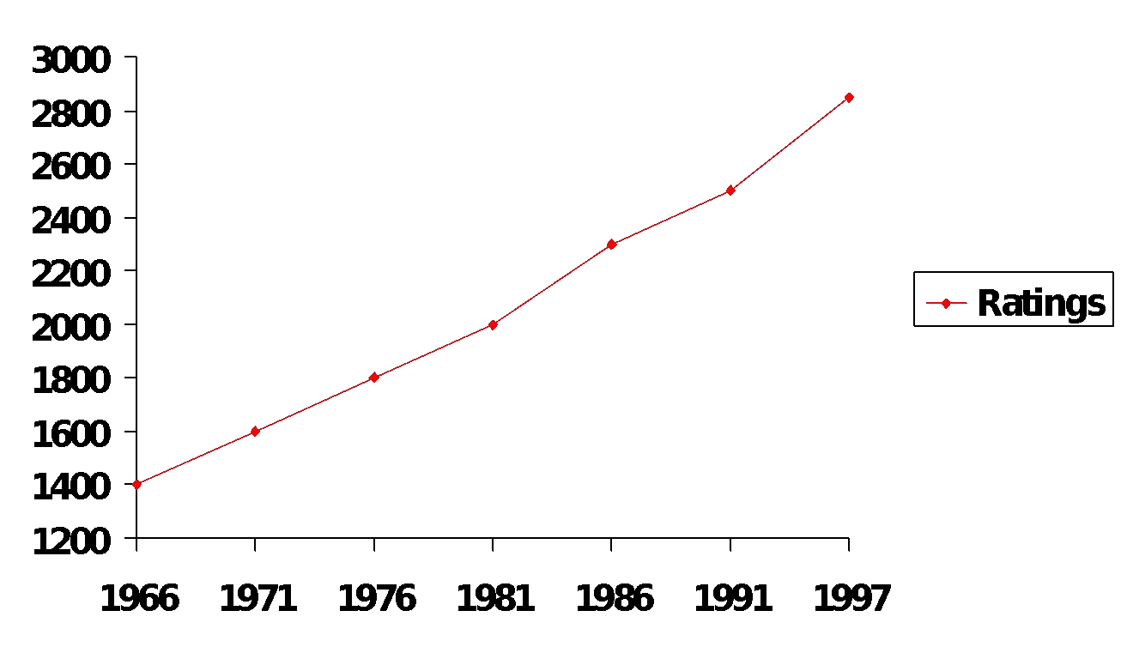
Can Computers beat Humans at
Chess?
Chess Playing is a classic AI problem
› well-defined problem
› very complex: difficult for humans to play well
Deep Blue
Human World Champion
Deep Thought
Points Ratings
Conclusion:
› YES: today’s computers can beat even the best human

Slide 91
Can we build hardware as complex as the brain?
How complicated is our brain?
› a neuron, or nerve cell, is the basic information processing unit
› estimated to be on the order of 10 ¹² neurons in a human brain
› many more synapses (10 ¹⁴) connecting these neurons
› cycle time: 10 ⁻³ seconds (1 millisecond)
How complex can we make computers?
› 10⁸ or more transistors per CPU
› supercomputer: hundreds of CPUs, 10¹² bits of RAM
› cycle times: order of 10 ⁻ ⁹ seconds
Conclusion
› YES: in the near future we can have computers with as many basic processing elements as our brain, but with
  far fewer interconnections (wires or synapses) than the brain
  much faster updates than the brain
› but building hardware is very different from making a computer behave like a brain!

Slide 92
Can Computers Talk?
This is known as “speech synthesis”
› translate text to phonetic form
  e.g., “fictitious” -> fik-tish-es
› use pronunciation rules to map phonemes to actual sound
  e.g., “tish” -> sequence of basic audio sounds
Difficulties
› sounds made by this “lookup” approach sound unnatural
› sounds are not independent
  e.g., “act” and “action”
  modern systems (e.g., at AT&T) can handle this pretty well
› a harder problem is emphasis, emotion, etc
  humans understand what they are saying
  machines don’t: so they sound unnatural
Conclusion:
› NO, for complete sentences
› YES, for individual words

Slide 93
Can Computers Recognize Speech?
Speech Recognition:
  mapping sounds from a microphone into a list of words
  classic problem in AI, very difficult
    “Lets talk about how to wreck a nice beach”
    (I really said “ ”)
Recognizing single words from a small vocabulary
systems can do this with high accuracy (order of 99%)
e.g., directory inquiries
  limited vocabulary (area codes, city names)
  computer tries to recognize you first, if unsuccessful hands you over to a human operator
  saves millions of dollars a year for the phone companies

Slide 94
Recognizing human speech (ctd.)
Recognizing normal speech is much more difficult
  speech is continuous: where are the boundaries between words?
    e.g., “John’s car has a flat tire”
  large vocabularies
    can be many thousands of possible words
    we can use context to help figure out what someone said
Conclusion:
NO, normal speech is too complex to accurately recognize
YES, for restricted problems (small vocabulary, single speaker)

Slide 95
Can Computers Understand speech?
Understanding is different to recognition:
  “Time flies like an arrow”
    assume the computer can recognize all the words
    How
Conclusion: NO, much of what we say is beyond the capabilities of a computer to understand at present
    many different interpretations are there?

Slide 96
Can Computers Learn and Adapt ?
Learning and Adaptation
› consider a computer learning to drive on the freeway
› we could teach it lots of rules about what to do
› or we could let it drive and steer it back on course when it heads for the embankment
  systems like this are under development (e.g., Daimler Benz)
  e.g., RALPH at CMU
    in mid 90’s it drove 98% of the way from Pittsburgh to San Diego without any human assistance
› machine learning allows computers to learn to do things without explicit programming
› many successful applications:
  requires some “set-up”: does not mean your PC can learn to forecast the stock market or become a brain surgeon
Conclusion: YES, computers can learn and adapt, when presented with information in the appropriate way

Slide 97
Can Computers “see”?
Recognition v. Understanding (like Speech)
  Recognition and Understanding of Objects in a scene
    look around this room
    you can effortlessly recognize objects
    human brain can map 2d visual image to 3d “map”
Why is visual recognition a hard problem?
Conclusion:
  mostly NO: computers can only “see” certain types of objects under limited circumstances
  YES for certain constrained problems (e.g., face recognition)

Slide 98
Can computers plan and make optimal decisions?
Intelligence
  involves solving problems and making decisions and plans
  e.g., you want to take a holiday in Brazil
    you need to decide on dates, flights
    you need to get to the airport, etc
    involves a sequence of decisions, plans, and actions
What makes planning hard?
  the world is not predictable:
    your flight is canceled or there’s a backup on the 405
  there are a potentially huge number of details
    do you consider all flights? all dates?
– no: commonsense constrains your solutions
  AI systems are only successful in constrained planning problems
Conclusion: NO, real-world planning and decision-making is still beyond the capabilities of modern computers
  exception: very well-defined, constrained problems

Slide 99
AI Technique
Intelligence requires Knowledge
Knowledge posesses less desirable properties such as:
  Voluminous
  Hard to characterize accurately
  Constantly changing
  Differs from data that can be used
AI technique is a method that exploits knowledge that should be represented in such a way that:
  Knowledge captures generalization
  It can be understood by people who must provide it
  It can be easily modified to correct errors.
  It can be used in variety of situations

Slide 100
Next Topics
Uninformed search
  Breadth-first, depth-first
  Uniform cost
  Iterative deepening
Informed (heuristic) search
  Greedy best-first
  A*
  Memory-bounded heuristic search
  And more….
Local search and optimization
  Hill-climbing
  Simulated annealing
  Genetic algorithms

